Slide 1
JAVA
Introduction to java

Slide 2
Java
Java was developed by Sun Microsystems Inc. in 1991.
Later acquired by Oracle Corporation.
It was developed by James Gosling and Patrick Naughton.
It is a simple programming language.
Writing, compiling and debugging a program is easy in java.

Slide 3
Why Use Java?
Java works on different platforms (Windows, Mac, Linux, Raspberry Pi, etc.)
It is one of the most popular programming language in the world
It is easy to learn and simple to use
It is open-source and free
It is secure, fast and powerful
It has a huge community support (tens of millions of developers)

Slide 4
Java Terminology
Before we discuss java terminology . Lets see program execution phases
Write the program code
Compile the program code
Run the program

Slide 5
Java Terminology ……
Writing of the program is of course done by java programmer like you and me.
Compilation of program is done by JAVAC compiler, JAVAC is the primary java compiler included in java development kit (JDK). It takes java program as input and generates java bytecode as output.
In third phase, JVM executes the bytecode generated by JAVAC compiler. This is called program run phase.

Slide 6
Java is a Platform Independent
Compiler(javac) converts source code (.java file) to the byte code(.class file).
As mentioned above, JVM executes the bytecode produced by compiler.
This byte code can run on any platform such as Windows, Linux, Mac OS etc. Which means a program that is compiled on windows can run on Linux and vice-versa.
Each operating system has different JVM, however the output they produce after execution of bytecode is same across all operating systems.
That is why we call java as platform independent language.

Slide 7
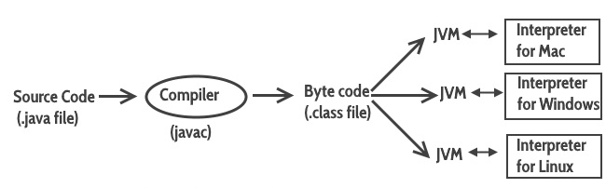
Java is a Platform Independent

Slide 8
Bytecode
As discussed above, javac compiler of JDK compiles the java source code into bytecode so that it can be executed by JVM.
The bytecode is saved in a .class file by compiler.

Slide 9
Java Development Kit(JDK)
As the name suggests this is a complete java development kit that includes JRE (Java Runtime Environment), compilers and various tools like JavaDoc, Java debugger etc.
In order to create, compile and run Java program you would need JDK installed on your computer.

Slide 10
Java Runtime Environment(JRE)
JRE is a part of JDK which means that JDK includes JRE.
When you have JRE installed on your system, you can run a java program however you won’t be able to compile it.
JRE includes JVM.When you only need to run a java program on your computer, you would only need JRE.
These are the basic java terms that confuses beginners in java.

